Slide 1
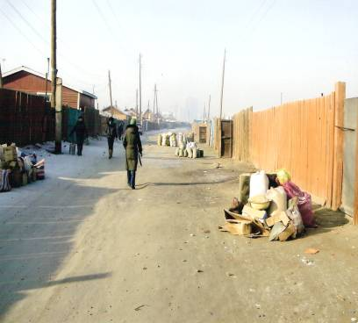
Green Coalition
“Mongolian National Green Coalition”NGO
“Waste Management” project

Slide 2
content
General information
Purposes and intent of“waste management”project
implementation
Results
Works in further

Slide 3
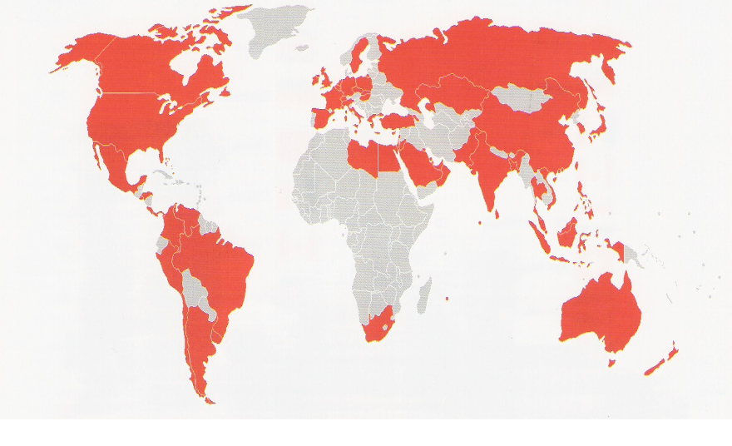
MONGOLIA
territory: 1 566 500 м.square
population: 2 706 272

Slide 4
Ulaanbaatar, capital of MONGOLIA
TERRITORY:
7300 m.sq
population:
1251740
district:
central 6
Sub district:
130
Dry waste:
260 -280 thousand ton/year, including 40-50% transportation off
Stockpiling of the fund of ‘’waste service’’:
3 bln tugrics/year

Slide 5
Territory of project implementation of BZ district, sub strickt 14, consulate street
BZ district has 14 sub district
Number of parts:
5
families: 1242 or 3700 peoples

Slide 6
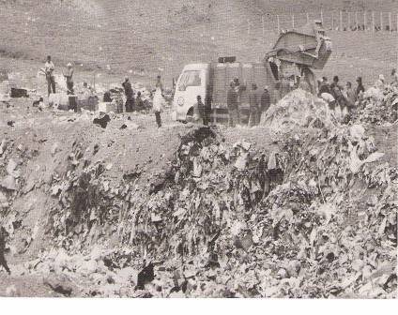
Disposal site on “ULAAN CHULUUT’’
since1975 disposal site of 20 sub districts of Shukhbaatar district
since2000 disposal site of 6 central districts of UB.
‘’Ulaan chuluut’’ waste point includes to itself 19 hectares.
At the going time about 5 million tons of waste with 5m thin.
winter 160-170 trucks/day
summer 200 trucks/day
At the closing time , April 2009 ,350 million tugriks budgeted from City budget for covering open waste and reducing negative influence on environment.
40 workers for cleaning and greening
36 trucks and bulldozers
15429 trucks or 89488.2 tons of clays
established 30 pipes removing gas from covered waste.
cleaned up 10 combs
built 500 m3 of concrete fence
made for 45 days
(Өглөөний сонин .Хотын амьдрал 2009.7.16 Пүрэв гараг .Дугаар 030)
Before April 2009
July 16 2009

Slide 7
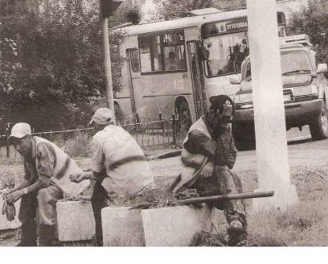
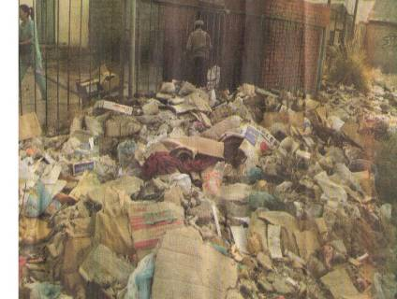
City cleaning and greening companies /CGC/and Fund of waste service/FWS/
CGC of 6 districts and 700З workers
Since 2007 founded FWS by law about waste approved in 2004
5 districts obtain FWS
khan uul district has not FWS
reason s for worse activities of districts with FWS :
payment for waste to FWS /588 million tugrics a year/
CGC transport off / spend 588 million *41%/ (Өглөөний сонин Хотын амьдрал 2009.1.26 Даваа гараг
Дугаар 016, Өдрийн сонин.2009.1.23 )

Slide 8
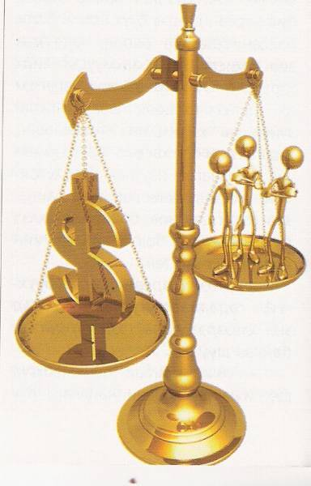
Stimulation system
For example:
Open doors days of environment protection under ‘’living without waste’’
Found sample waste point
Transporting off waste
cleaning
Reusing processing progressive technology
Stimulate 15 heads of districts and sub districts and 2 directors of CGC which fully cleaned up
Travelling abroad Head of best district and CGC for experience studying.
..................

Slide 9
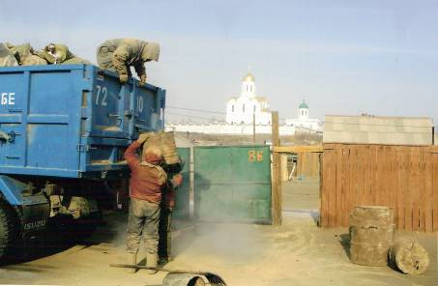
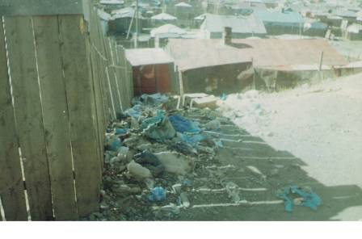
“waste management ‘’ project
Before implementaion of projekt,2007:
BZ district had 25 sub districts
161 million tugricks spent for transportation wastes to Ulaan chuluut ‘’disposal site in season
8.5 million tugricks spent for BZD’s 14 sub districts transportation of 546 tons of wastes /153 trucks/
payment:
500million tugricks /year
ratio of payment
Can we change this situation ?

Slide 10
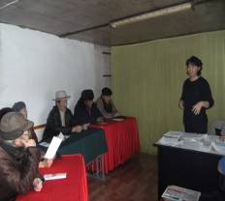
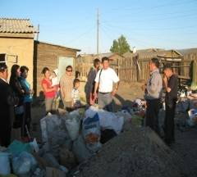
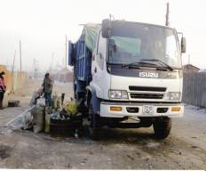
“waste management ‘’ project
implementator:
citizen Daramrenchin
Green Coalition and
“Mongolian national green movement’’ NGO
citizens
financer;:
“Mobicom”co.,ltdХХК
partner:
CGC, FWS of Bayan zurkh district and head of sub district
Recipients of Project results :
,114 families, consulate street,Bayan zurkh district , sub district 14-
Number of officers:
4
term:
2008.09.01 – 2009.12.31

Slide 11
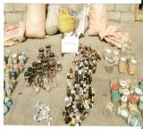
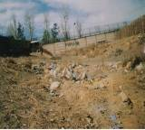
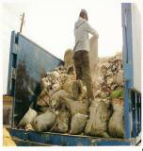
“waste management ‘’ project
purposeо: activate each participation in providing comfortable, health conditions of living and working, improve environment by spreading
duties and responsibilities
task:
1.Avtivate citizens participation in improving service quality of waste transportation.
2. Inure citizen to different the waste/80:20/
3.Fix expedient variant payment for waste
4. Crease waste size and reduce expense for waste transportation
5.Found reprocessing of waste ‘’partners 3’’/ glass, polyethylene pack and mole

Slide 12
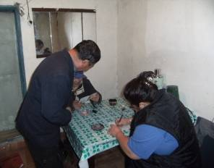
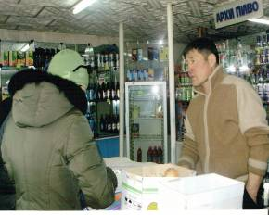
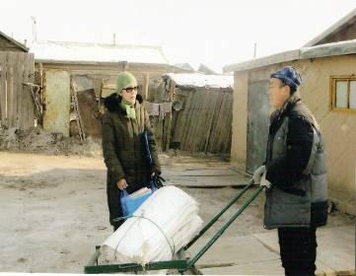
“waste management ‘’ project
implementation:
conversation with each of 114 families and spread following materials:
introduce the project
Cooperation agreement
variants if waste paymentsтөлөх хувилбарууд
Registration
List of buying second raw materials
Different the waste put into purse
cooperation with head of sub district
coordinate transportation of waste in cooperation with FWS
activate citizens
continue stability the project activities in further.
task

Slide 13
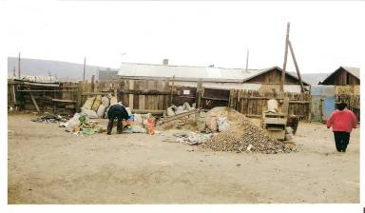
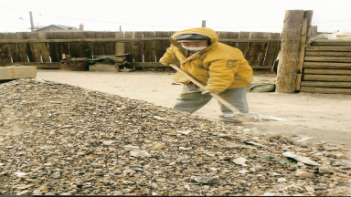
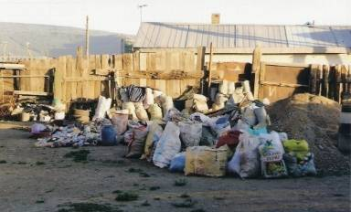
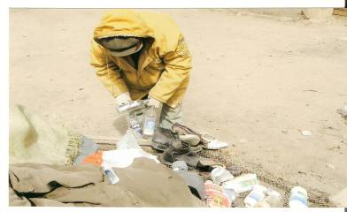
“waste management ‘’ project
implementation:
Centralize the waste: 34 тn of waste
implementation:
Different the waste: reusing 32 tons of waste

Slide 14
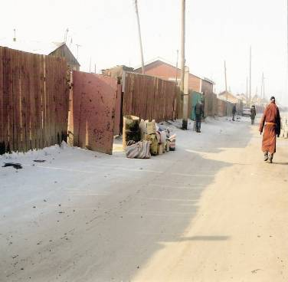
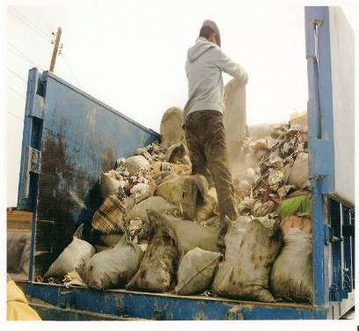
“waste management ‘’ project
implementation:
Waste transportation:
2 trucks

Slide 15
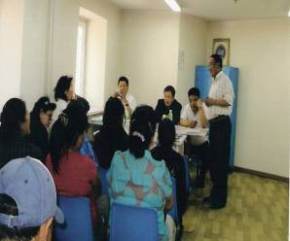
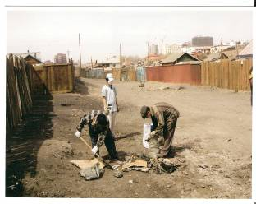
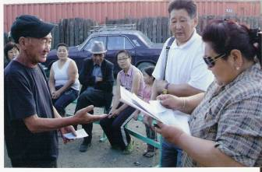
“waste management ‘’ project
results:
increased number of participated citizens
Actively participated 80% families in common cleaning
differenced waste 50% of 114 families
Family of 4-5 members gives 2-3 кg/month of waste
Transportation expense reduced by 70% according to number of transportation Хог
clean environment
decided to bake agreement on cooperation between head of BZ district and citizens representatives
decision on foundation of working division from BZ district staff

Slide 16
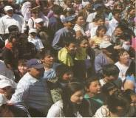
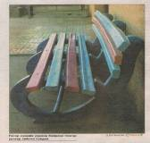
“waste management ‘’ project
Works in further:
continue project activities certainly
organize training to change citizens understanding and trends about waste and campaniles
Propaganda on advanced experience
reusing the waste for raw materials and support processing factories
establish system of stimulation and responsibility
Policy support of state for partnering
Reprocessing factor of first stage waste“san-orgiu
”co.,ltd

Slide 17
Question and response
Thanks for attention

